Slide 1
SS ZG 526: Distributed Computing
Cluster Computing continued…
Acknowledgement: Adapted from Kai Hwang, University of Southern California
Chittaranjan Hota
Professor, Dept. of Computer Sc. & Information Systems
BITS, Pilani Hyderabad Campus, Hyderabad
hota@hyderabad.bits-pilani.ac.in

Slide 2
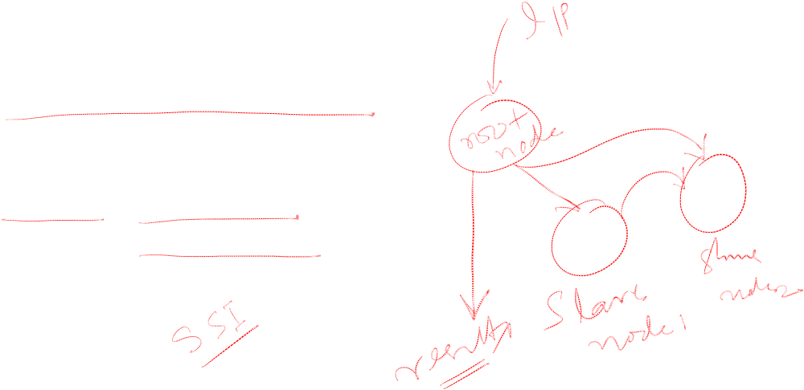
What is a computing cluster?
A computing cluster consists of a collection of interconnected stand-alone/complete computers, which can cooperatively work together as a single, integrated computing resource. Cluster explores parallelism at job level (load balancing) and distributed computing with higher availability (fail over).
Birla Institute of Technology and Science, Pilani (Deemed University)

Slide 3

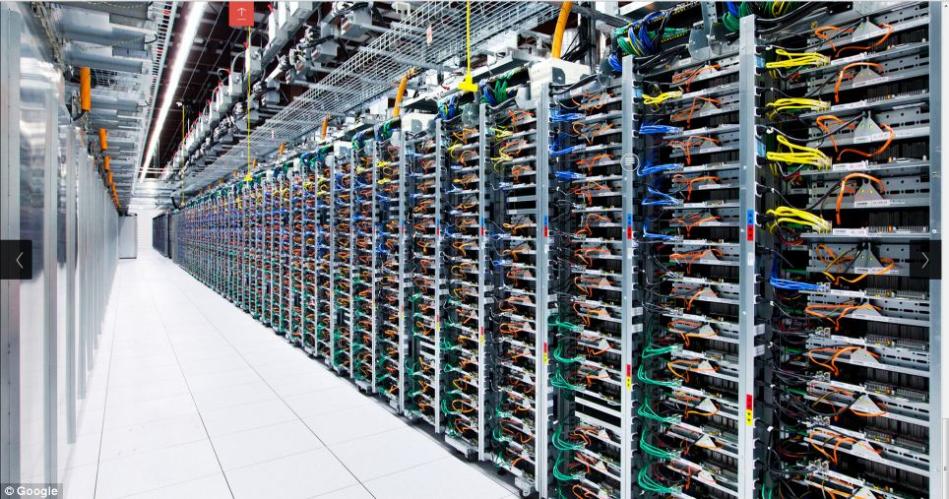
Cluster classification
Scalability : Adding servers to a cluster or adding more clusters to a network as the application need arises.
Packaging : Compact / Slack
  Compact – packaged in racks in machine room
  Slack – PC, workstations geographically distributed
Control : Centralized / De-centralized.
Homogenaity: Same vs. different platforms (e.g. CPUs, OSs)
Programmability : Ability to run a variety of applications.
Security : Exposure of intra-cluster communication.
Source: Wiki
Birla Institute of Technology and Science, Pilani (Deemed University)

Slide 4

Operational Benefits of Clustering
High availability (HA) : Cluster offers inherent high system availability due to the redundancy of hardware, operating systems, and applications.
OS and application reliability : Run multiple copies of the OS and applications.
Scalability : Adding servers to a cluster or adding more clusters to a network as the application need arises.
High Performance : Running cluster enabled programs to yield higher throughput.
Birla Institute of Technology and Science, Pilani (Deemed University)

Slide 5
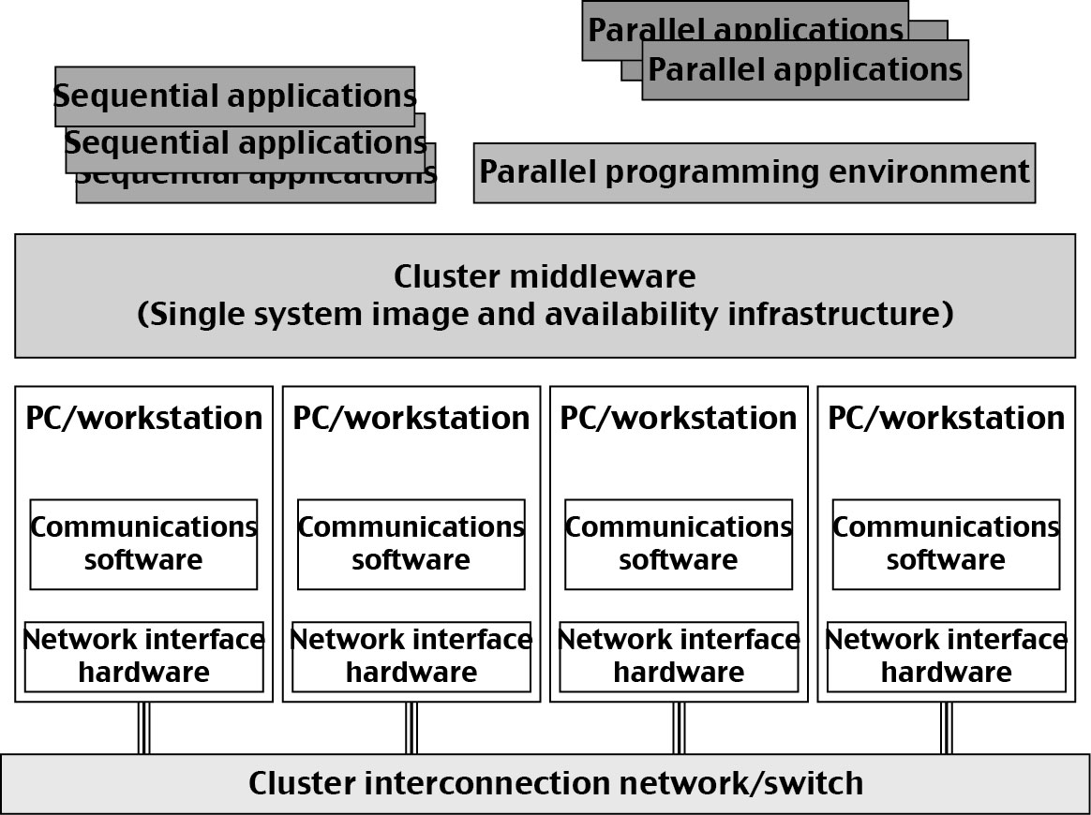

Computer Cluster Architecture
Birla Institute of Technology and Science, Pilani (Deemed University)

Slide 6

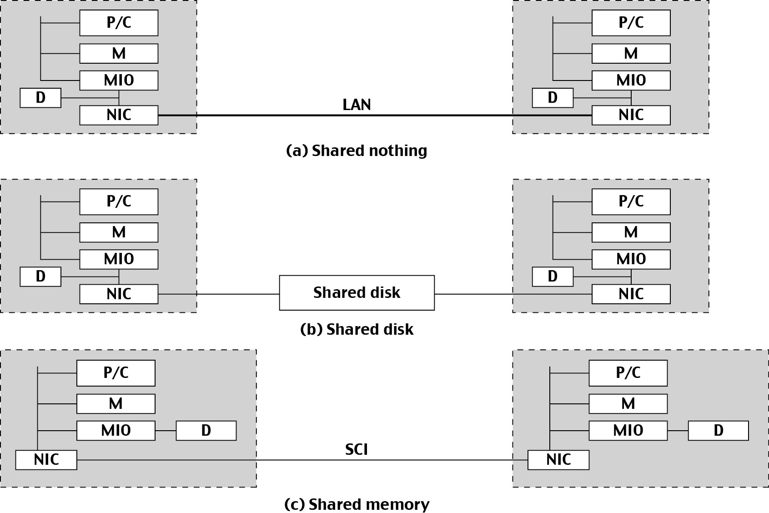
HA and Performance: Resource sharing in Clusters
Connected through the I/O bus
Check-pointing, rollback recovery etc.
Scalable coherence interface ring
Birla Institute of Technology and Science, Pilani (Deemed University)

Slide 7

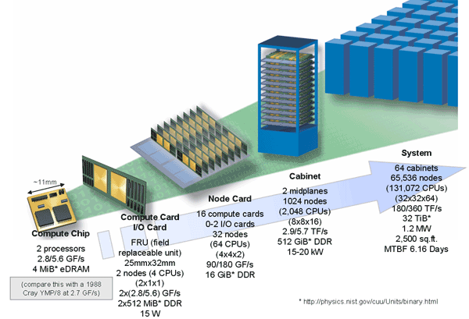
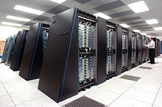
MPP Packaging Architecture
A Blue Gene/P supercomputer at Argonne National Laboratory
IBM BlueGene/L Supercomputer: The World Fastest Message-Passing MPP built in 2005
Birla Institute of Technology and Science, Pilani (Deemed University)

Slide 8

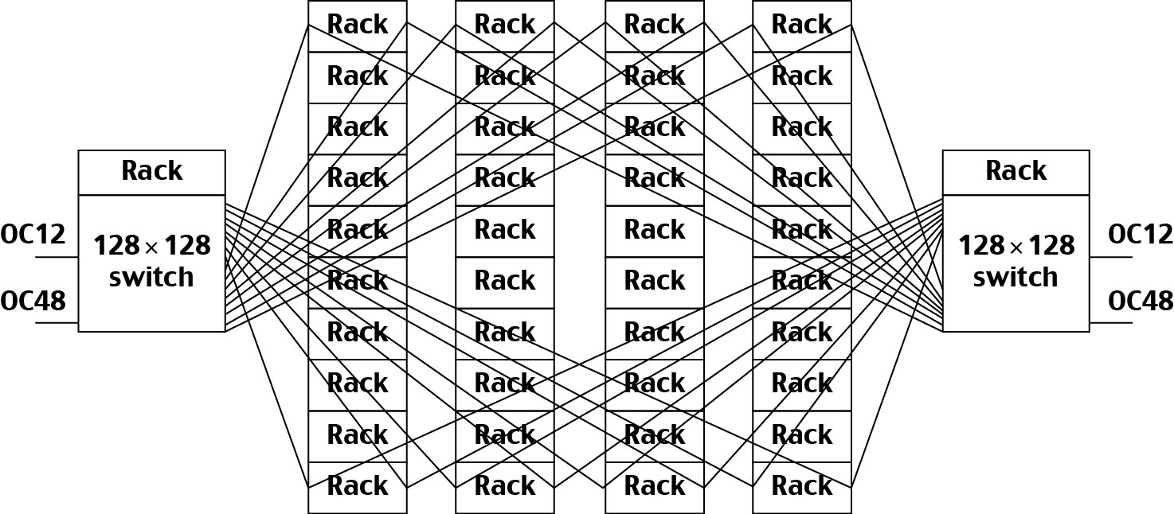
Google search engine cluster
A Rack contains 80 PCs.
Cross bar switch Interconnect
Birla Institute of Technology and Science, Pilani (Deemed University)

Slide 9

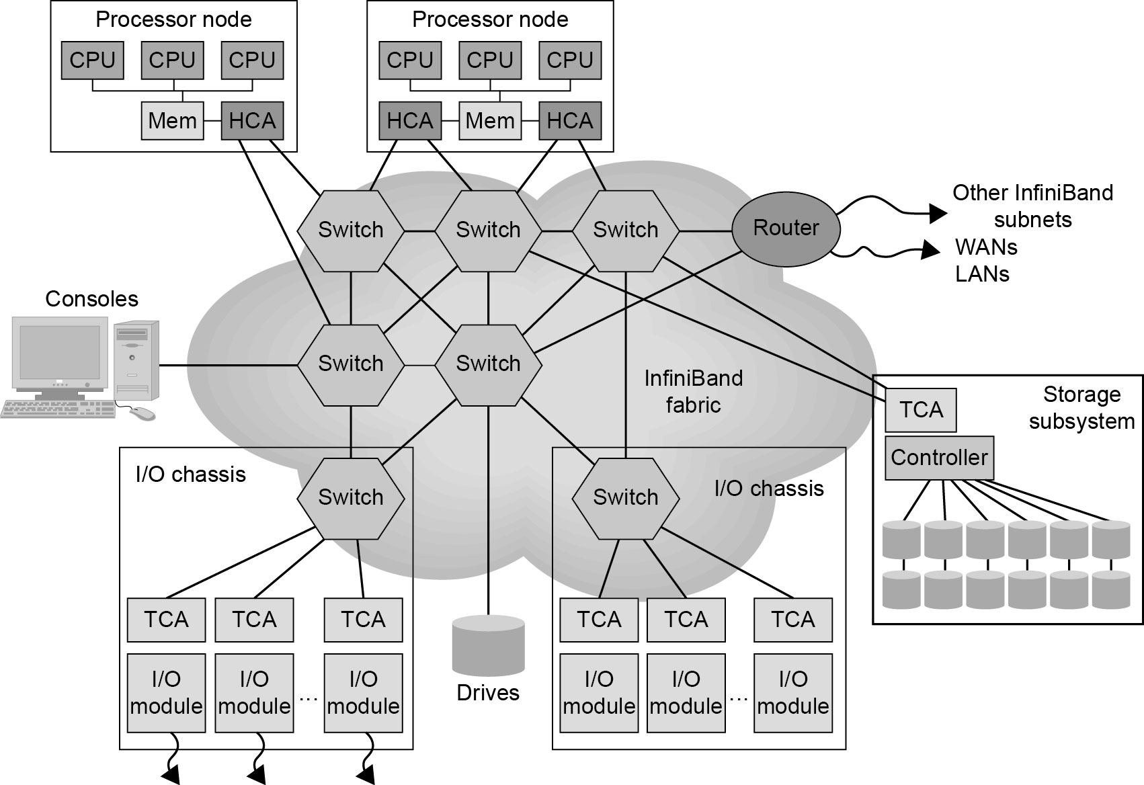
InfiniBand architecture
HCA – Host Channel Adapter. An HCA is the point at which an InfiniBand end node, such as a server or storage device, connects to the InfiniBand network.
TCA – Target Channel Adapter. This is a specialized version of a channel adapter intended for use in an embedded environment such as a storage appliance.
Birla Institute of Technology and Science, Pilani (Deemed University)

Slide 10

Design Principles of Computer Clusters
Single System: The entire cluster is viewed by the users as one system, which has multiple processors. User could say execute my job using 7 processors.
Single Control: Logically, an end user or system user utilizes services from one place with a single interface.
Symmetry: A user can use a cluster service from any node. All cluster services and functionalities are symmetric to all nodes and all users, except those protected by access rights.
Location Transparent: The user is not aware of the whereabouts of the physical device that eventually provides a service.
Birla Institute of Technology and Science, Pilani (Deemed University)

Slide 11

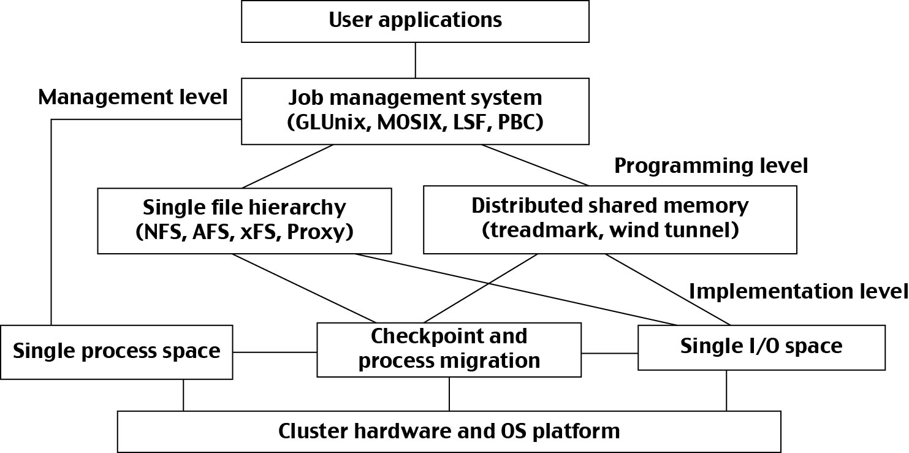
Middleware Support for SSI Clustering:
Birla Institute of Technology and Science, Pilani (Deemed University)

Slide 12

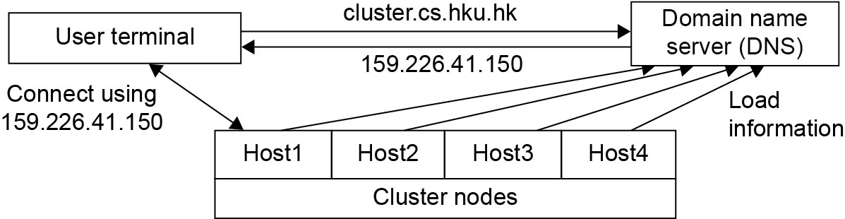
Realizing a single entry point in a cluster
Four nodes of a cluster are used as host nodes to receive users’ login requests.
To log into the cluster a standard Unix command such as “telnet cluster.cs.hku.hk”, using the symbolic name of the cluster system is issued.
The symbolic name is translated by the DNS, which returns with the IP address 159.226.41.150 of the least-loaded node, which happens to be node Host1.
The user then logs in using this IP address.
The DNS periodically receives load information from the host nodes to make load-balancing translation decisions.
Birla Institute of Technology and Science, Pilani (Deemed University)

Slide 13
Next session
Design components of cluster computers
Birla Institute of Technology and Science, Pilani (Deemed University)

